Slide 1
Interpreting a report

Slide 2
Objectives
Interpreting a report
Being able to make decisions based on the tests performed
Analysing a complex example
Notes:
The annex 11 of the WHO TEAM report Recommendations for improving the quality of anthropometric data collection, analysis and reporting
is a good checklist of what we expect from a data quality survey report. Could be mentioned or shared during this sessionor next to evaluate if data quality tests have been performed and have been presented in a clear report.

Slide 3
SMART Survey
Interpreting a report
Policy makers in the Philipines want to have a detailed understanding of the nutrition situation in the region of Lanao focusing on Acute Malnutrition.
A National Survey was done 3 years ago and provides regional figures.
A local survey has been conducted recently in the region of Lanao using the SMART methodology. This survey can provide complementary information.
But the data quality need to checked.

Slide 4
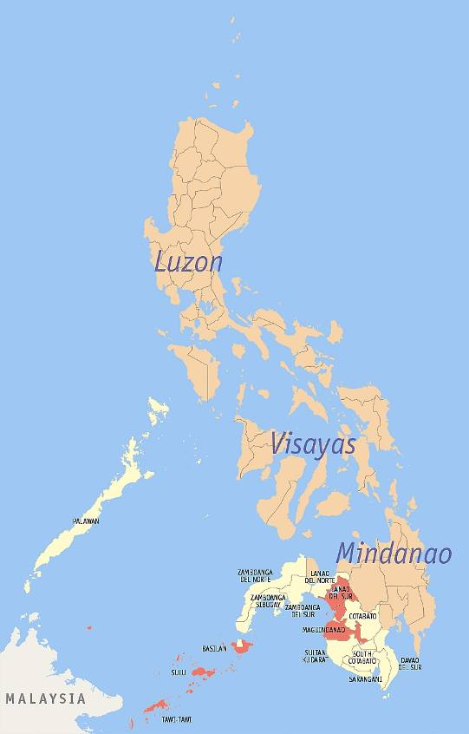
Where?

Slide 5
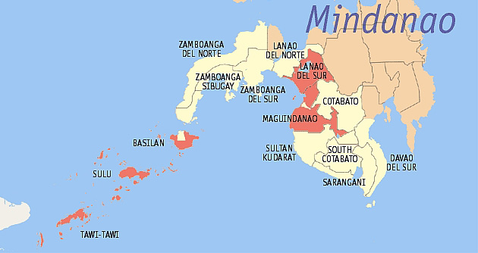

Slide 6
Acute malnutrition prevalence
 | (n) = 862 (C.I. 95%)
Prevalence of global acute malnutrition | (57) 6,6 % (4,8-9,0)
Prevalence of moderate acute malnutrition | (45) 5,2 % (3,7-7,4)
Prevalence of severe acute malnutrition | (12) 1,4 % (0,7 - 2,8)
Notes:
The results were as follow.

Slide 7
Excercise 2
Interpreting a report
The local survey measured a prevalence of GAM in Lanao del Sur lower than expected.
You are tasked to review the level of data quality of this local SMART survey

Slide 8
Excercise 2
Interpreting a report
You have access to:
Full report
Annexes
Data quality report from SMART
Full data in Excel
Simplified data version in .CSV
Notes:
The full data contains additional information on more variables so it is recommended to use the CSV file

Slide 9
Excercise 2
Interpreting a report
Read the methodology section of the report and prepare your data file
Use the check list you did on day 1 to see if the methodology can produce good quality results
Do your own tests on the data, do not trust the data quality report from SMART
Give a recommendation whether to use this survey or not in your analysis

